Slide 1

ENVIRONMENT IMPACT ASSESMENT
PROF. KAMLESH PARIHAR
ASSOCIATE PROF.
CIVIL ENGINEERING DEPARTMENT
JIET JODHPUR

Slide 2
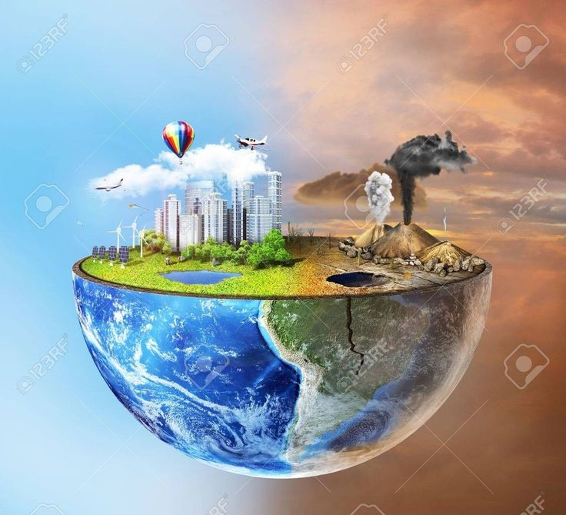
ENVIRONMENT IMPACT ASSESMENT

Slide 3
Definition OF EIA
Environmental impact assessment (EIA) can be defined as the systematic identification and evaluation of the potential impacts (effects) of proposed projects, plans, programs, or legislative actions relative to the physical, chemical, biological, cultural, and socioeconomic components of the total environment.
According to United Nations, EIA as an assessment of impacts of a planned activity on the environment.
According to International Association of Impact Assessment (IAIA), EIA is the systematic process to identify the future consequences of a current or proposed action.
According to Department of Environment, United Kingdom, EIA as a technique and a process by which information about environmental effects of a project is collected, both by the developer and from other sources, and taken into account by the planning authority in forming the judgment on whether the development should proceed.

Slide 4
Eis (Environment Impact Statement)
An Environmental Impact Statement (EIS) is a document prepared to describe the effects for proposed activities on the environment. Here, "Environment,", is defined as the natural and physical environment and the relationship of people with that environment. This means that the "environment" considered in an EIS includes land, water, air, structures, living organisms, environmental values at the site, and the social, cultural, and economic aspects. An "impact" is a change in consequence that results from an activity. Impacts can be positive or negative or both. An EIS describes impacts, as well as ways to "mitigate" impacts. To "mitigate" means to lessen or remove negative impacts. Public Consultation is an important in EIS. It will be discussed in detail in unit 3.

Slide 5
EMP (Environmental Management Plan)
Environmental Management is the process of allocating natural and artificial resources so as to make optimum use of the environment in satisfying basic human needs at the minimum, and more if possible, on a sustainable basis.
It can also be defined as a generic description of a process undertaken by systems-oriented professionals with a natural science, social science, or less commonly an engineering, law, or design background, tackling problems of the human altered environment on a interdisciplinary basis from an quantitively and or futuristic viewpoint.
A well formed and documented action plan which describes above activities is called as environmental management plan.

Slide 6
Projects which need eia
ACCORDING TO EIA NOTIFICATION 2006, GOVERNMENT OF INDIA
Mining
River valley project (Construction of Dam, Hydroelectric Power Project)
Off shore and On Shore Oil Exploration
Thermal Power Plants
Nuclear Power Plants
Coal Washeries
Cement Plant
Chemical Refinery / Chemical Manufacturing Factory
Industries of Leather/Skin/Synthetic Materials, Chemical and Dye, Paper & Pulp, Hazardous Materials etc. having any effect on environment.

Slide 7
Characteristics of EMP
It is often used as a generic term. It supports sustainable development. It deals with a world affected by human beings. It demands a multidisciplinary or interdisciplinary approach. It has to integrate different development viewpoints. It seeks to integrate science, social science, policy-making and planning. It recognizes the desirability of meeting, and if possible exceeding basic human needs. The time-scale involved extends beyond the short-term and concerns range from local to global. It should show opportunities as well as address threats and problems.
It stresses stewardship, rather than exploitation.

Slide 8
Effect of human activities on environment

Slide 9
Effect of human activities on environment
Human Activities That Affect The Environment Are
Deforestation:
Water Pollution:
Air Pollution:
Exploitation of Marine Life:
Global Warming:
Habitat Loss:
Extinction:
Overuse Of Harmful Pesticides And Fertilizers:
Urbanization:
Ozone Layer Depletion:

Slide 10
Ecosystem AND ECOLOGY
An ecosystem is a geographic area where plants, animals, and other organisms, as well as weather and landscape, work together to form a bubble of life. Ecosystems contain biotic or living, parts, as well as abiotic factors, or nonliving parts. Biotic factors include plants, animals, and other organisms. Abiotic factors include rocks, temperature, and humidity.
Ecology is the study of the relationships between living organisms, including humans, and their physical environment; it seeks to understand the vital connections between plants and animals and the world around them. Ecology also provides information about the benefits of ecosystems and how we can use Earth’s resources in ways that leave the environment healthy for future generations.

Slide 11
ECOLOGICAL IMBALANCE
Humans and all living beings are constantly interacting with the physical environment. The activities they perform, have an impact on the environment variables, i.e. air, water and land. But inspite of these activities, the environment is constantly calibrating itself and maintaining an equilibrium. But there is limit of the environment to sustain this equilibrium. In recent past the human activities have far superseded the capacity of environment to sustain this equilibrium. As a result of this, the equilibrium has been disturbed and environment variables are adversely affected. May it be the quality of air, water or land, everything is getting degraded due to pollution.
This change in environment variables is termed as ecological imbalance. It can explained in a more sophisticated ways as given below.
The stability of ecosystem refers to balance between production and consumption of each element in the ecosystem. In other words, ecosystem stability means balance between input and output of energy and normal functioning of different bio-geo-chemical cycles and stable conditions of concentration of all elements. Ecosystem instability also called as eco-imbalance refers to that state when an ecosystem is unable to adjust with environmental changes.

Slide 12
human activities That effect environment
Air | Surface water (e.g., lakes, rivers) | Groundwater | Coastal areas / marine | Land
Transportation (all modes) Energy (production, refining, and distribution) Generation of electricity (e.g., burning of coal, natural gas) Use of refrigerants and coolants (ozone-depleting substances) Metal smelting and other industrial activities (e.g., pulp and paper, chemical manufacturing, and other heavy industries) Mining of aggregates Application of pesticides Waste incineration Use of various volatile chemicals Heating (e.g., with wood, oil) | Removal of shoreline vegetation Forestry and Mining Collection, storage, and disposal of agricultural waste Application of pesticides Sewage discharges Industrial and other discharges (e.g., pulp and paper, mining, chemical, food processing) Spills and accidental releases of pollutants Boating and shipping (e.g., discharges of fuel, ballast water) Fuel storage, distribution, refuelling Draining and removal of wetlands Development of infrastructure (e.g., dams and bridges) | Extracting ground water for drinking and household and industrial activities Irrigation Manure management (e.g., collection, storage, disposal, or spreading) Fuel storage, distribution, and refuelling Waste disposal Urban development (removal of vegetation, increase in hard impervious surfaces) | Discharges of sewage or waste water Energy (exploration, production, distribution) Commercial fisheries Dredging Ocean dumping Boating and shipping (e.g., discharge of fuel, ballast water) Urban development (removal of coastal vegetation, including wetlands) Spills and accidental releases | Transportation infrastructure (roads, highways, bridges) Forestry and mining activities Agriculture (e.g., soil tilling, livestock grazing, fertilizers and pesticides) Spreading of solid waste and sewage sludge Storage and distribution of fuels and other hazardous materials (e.g., storage tanks) Landfilling of waste Spills and accidental releases Military training and testing (use of training areas for Fires and explosion)

Slide 13
effects of human activities on environment
Air | Surface water (e.g., lakes, rivers) | Groundwater | Coastal areas / marine | Land
Releases of carbon dioxide and other greenhouse gases that contribute to global warming Depletion of the ozone layer Impairment of air quality Smog (including particulates, ground-level ozone) Effects on human and wildlife health (e.g., upper respiratory problems and higher rates of hospitalization) Acidification of lakes and rivers (acid rain) Deposition of air pollutants on land | Reduction in quality of habitat for fish and other aquatic organisms Increased runoff and erosion Depletion of fish populations Impairment of water quality (pollutants, pathogens, bacteria, nutrients) Need for increased water treatment Increased algal growth/blooms Decreased biodiversity | Reduced groundwater quality (e.g., from pollutants, toxins, hydrocarbons, pathogens, bacteria) Impairment of drinking water quality Need for increased water treatment | Alteration or degradation of quality of fish and other marine habitat Depletion of fish populations Increased disease and pathogens affecting fish Impairment of water quality (e.g., pollutants, including petroleum products, pathogens, bacteria, nutrients) Introduction of exotic, invasive species Reduction of tourism activity | Depletion of fertile and agricultural land. Soil and groundwater contamination Erosion or desertification Reduction or removal of wildlife habitat Reduction or removal of wetlands Reduction in biodiversity (soil organisms, plants, wildlife) Increased surface water runoff or stormwater runoff

Slide 14
Comparison of Indian & China
PARAMETER | INDIA | CHINA
GOVERNMENT TYPE | DEMOCRATIC | COMMUNIST
POPULATION | 1.3 BILLION | 1.4 BILLION
AREA | 32 LAKH KM | 95 LAKH KM
EXTERNAL DEBT(USD) | 500 BILLION | 1500BILLION
FOREIGN RESERVE (USD) | 400 BILLION | 3200 BILLION
PURCHASING POWER(USD) | 9 TRILION | 25 TRILLION
GDP(USD) | 2.6 TRILLION | 14.9 TRILLION
LITERACY RATE | 78% | 96%
UNEMPLOYMENT RATE | 6% | 3%

Slide 15
Comparison of Indian & China
PARAMETER | INDIA | CHINA
GOVERNMENT TYPE | DEMOCRATIC | COMMUNIST
POPULATION | 1.3 BILLION | 1.4 BILLION
AREA | 32 LAKH KM | 95 LAKH KM
EXTERNAL DEBT(USD) | 500 BILLION | 1500BILLION
FOREIGN RESERVE (USD) | 400 BILLION | 3200 BILLION
PURCHASING POWER(USD) | 9 TRILION | 25 TRILLION
GDP(USD) | 2.6 TRILLION | 14.9 TRILLION
LITERACY RATE | 78% | 96%
UNEMPLOYMENT RATE | 6% | 3%

Slide 16
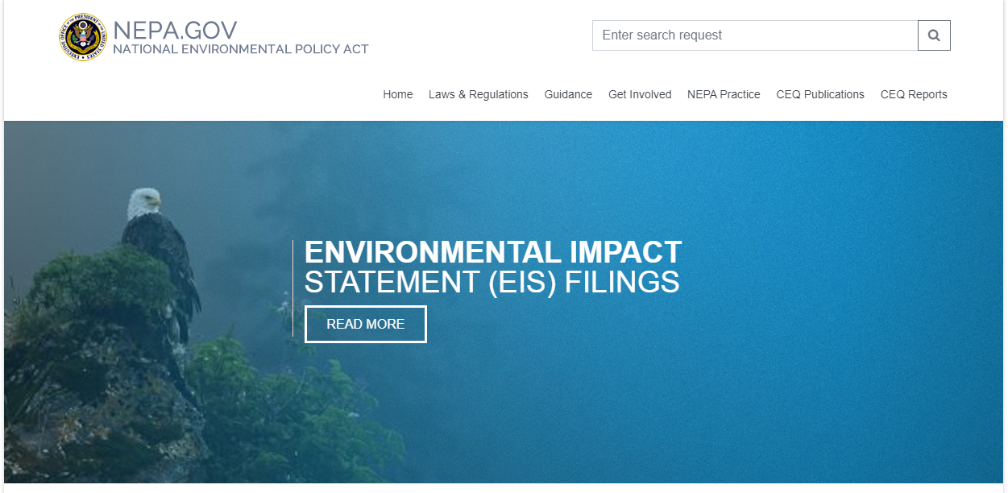
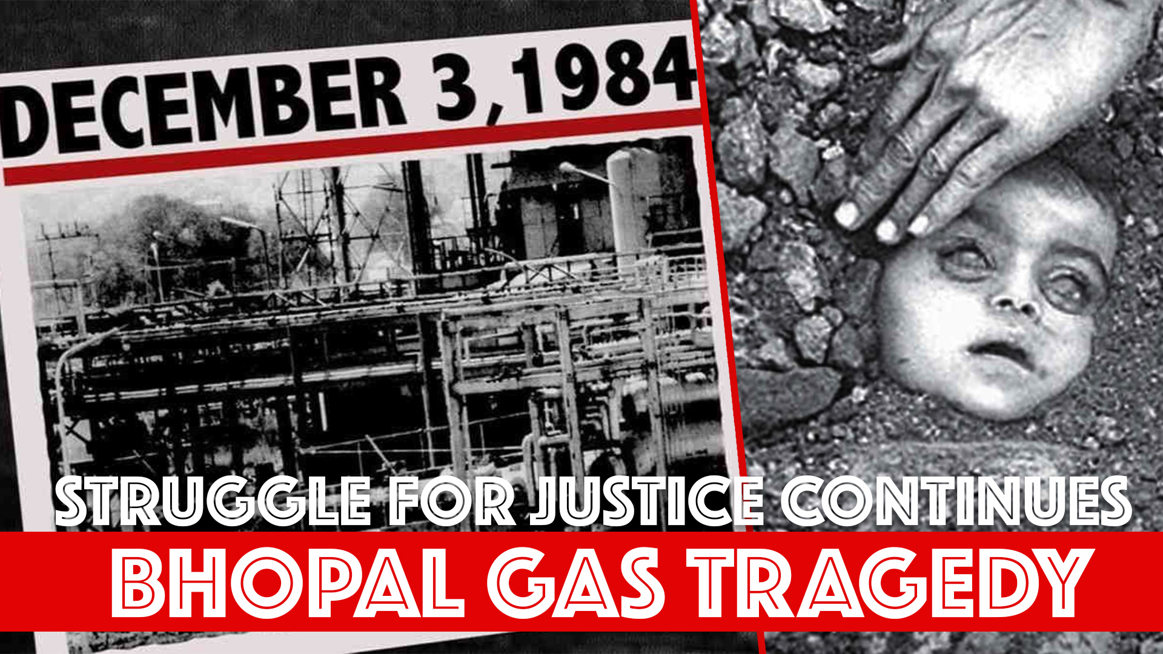
History of eia
First discussion on EIA started after a book Silent Spring Rachel Carson published in 1962. The book presented her research about the ill effects of synthetic pesticides on agriculture. In her book she accused the chemical industry of spreading disinformation, and public officials of accepting the industry's marketing claims unquestioningly. This book brought environmental concerns to the American public. After this book discussion started on environmental protection in America which then permeated to other countries.
In 1969, America became the first country to make EIA compulsory for all projects through its National Environmental Protection Act (NEPA).

Slide 17
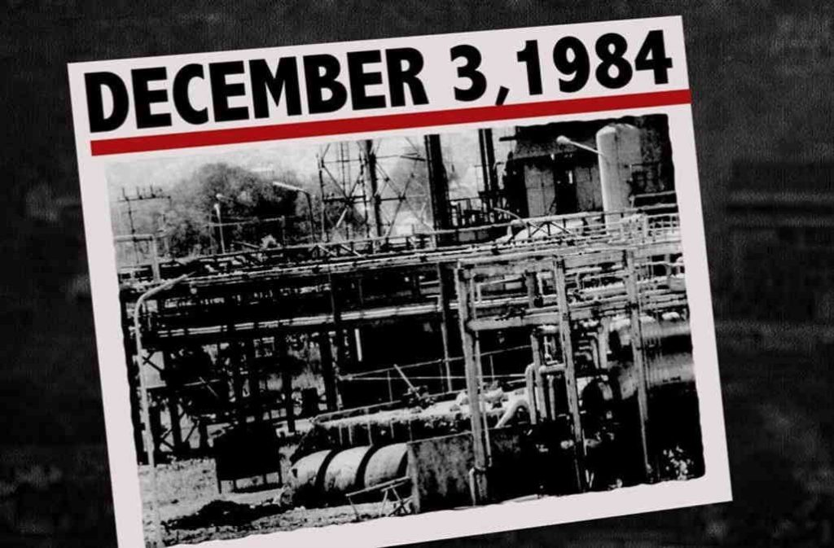
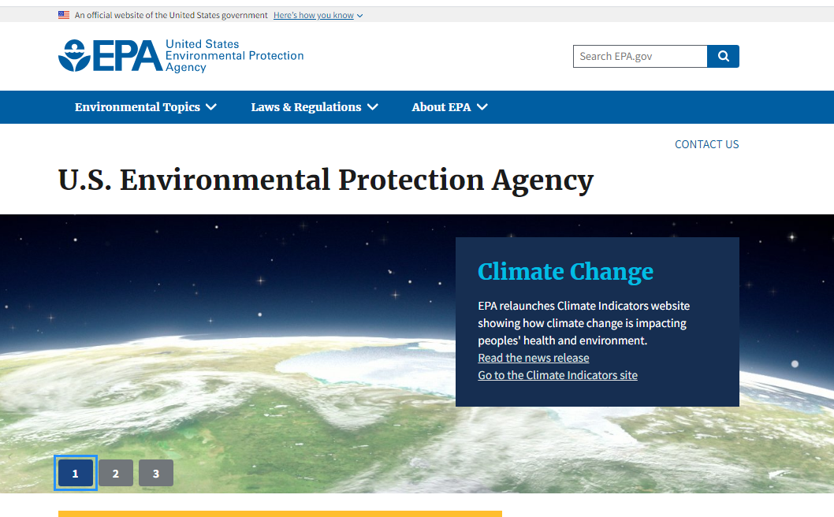
History of eia
In India, after Bhopal Gas Tragedy, Environmental Protection got attention and in 1986, Government of India enacted, Environmental Protection Act, but EIA was missing
In 1994, EIA was added as a norm to environmental protection act.
In EIA notification 2006, detailed procedure of EIA was mentioned by Government of India.

Slide 18
Types of environmental impacts ^{[1]}
Beneficial or detrimental
Naturally reversible or irreversible
Repairable via management practices or irreparable
Short term or long term
Temporary or continuous
Occurring during construction phase or operational phase
Local, regional, national, or global
Accidental or planned (recognized before hand)
Direct (primary) or indirect (secondary)
Cumulative or single

Slide 19
Steps in eia ^{[1]}
Project screening: Not all development projects require EIA. Project screening will help to identify the ones that actually do. This section describes the various screening criteria. This is done by CPCB
Scoping: The process of scoping helps determine the coverage or “scope” of the EIA. The methods of scoping are elaborated in this section.
Baseline data collection: A brief explanation on the concept of baseline data collection, its purposes, source of collection of baseline data, and derivation of primary data are given in this part of EIA process.
Identification of environmental impacts: Described here are the various types of environmental impacts of development projects both beneficial and adverse.

Slide 20
Steps in eia (contd..)
Impact prediction comparison of alternatives and determination of significance: This section covers the considerations for impact prediction, uncertainties in impact prediction, and comparison of alternatives for impact prediction.
Mitigation measures: Described briefly under this section are the concept and objectives, types, and interesting points of mitigation measures.
Public consultation and participation: Public participation is a necessary component of the EIA. “Who are the public?”, “How to involve them?”, and “What are the benefits/ disbenefits?” The answers can be found under this section. This mainly constitutes the report on the socioeconomic environment.

Slide 21
Steps in eia (contd..)
Environmental monitoring: As one of the most important aspects of EIA, “environmental monitoring” is defined here along with explanations on monitoring principles, types, and institutional aspects.
Environmental auditing: You will find under this section the various types of environmental auditing and when it should be carried out during the EIA

Slide 22
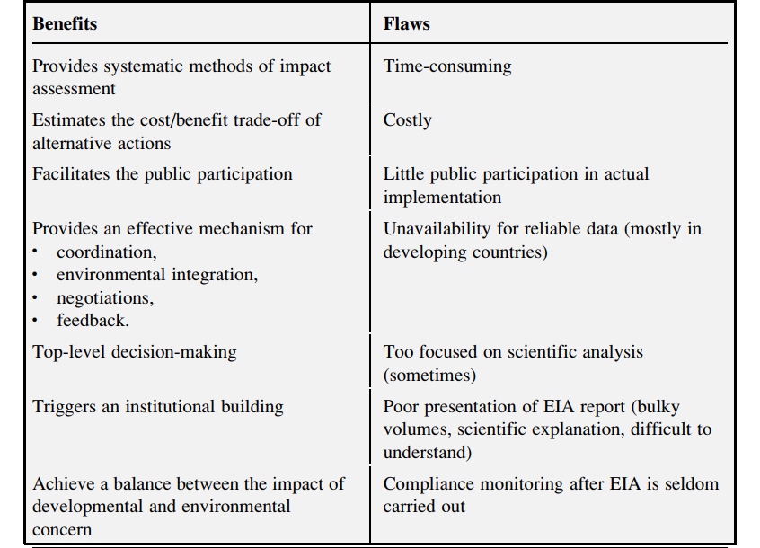
Eia benefits and flaws

Slide 23
INTERNATIONAL CONVENTIONS ON ENVIRONMENT
AN EFFORT OF WORLD TO PROTECT OUR MOTHER EARTH

Slide 24
List of All international conventions
Name | Year |  | Name | Year
COP24 | 2019 |  | KYOTO PROTOCOL | 1997
COP24 | 2018 |  | UNCCD | 1994
COP21 | 2016 |  | CONVENTION ON BIOLOGICAL DIVERSITY | 1992
KIGALI AMMENDMENT | 2016 |  | UNITED NATIONS FRAMEWORK ON CLIMATE CHANGE (UNFCCC) | 1992
MINAMATA CONVENTION | 2013 |  | RIO SUMMIT | 1992
NAGOYA PROTOCOL | 2010 |  | BASEL CONVENTION | 1989
UN-REDD | 2008 |  | MONTREAL PROTOCOL | 1987
STOCKHOLM CONVENTION | 2001 |  | VIENNA CONVENTION | 1985
CARTAGENA PROTOCOL ON BIOSAFETY | 2000 |  | BONN CONVENTION | 1979
ROTTERDAM CONVENTION | 1998 |  | RAMSAR CONVENTION | 1971

Slide 25
Basal, Rotterdam and Stockholm convention

Slide 26



Basel, Rotterdam & Stockholm conventions
Adoption
22 March 1989
10 September 1998
Entry into force
5 May 1992
24 February 2004
Number of Parties
183
154
22 May 2001
17 May 2004
179
BASEL CONVENTION

Slide 27
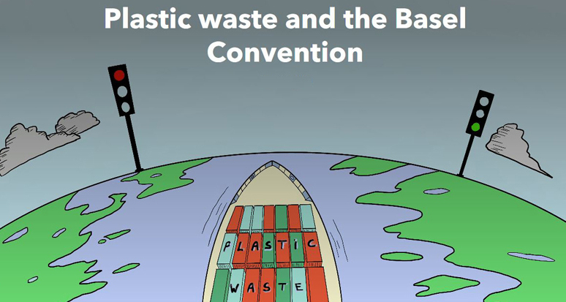
Basel Convention
The Basel Convention on the Control of Transboundary Movements of Hazardous Wastes and their Disposal was created to protect people and the environment from the negative effects of the inappropriate management of hazardous wastes worldwide. It is the most comprehensive global treaty dealing with hazardous waste materials throughout their lifecycles, from production and transport to final use and disposal.
Entered into force on 5 May 1992
To date it has 183 Parties

Slide 28
Rotterdam Convention
The Rotterdam Convention on the Prior Informed Consent (PIC) Procedure for certain hazardous Chemicals and Pesticides in international trade provides Parties with a first line of defense against hazardous chemicals. It promotes international efforts to protect human health and the environment as well as enabling countries to decide if they want to import hazardous chemicals and pesticides listed in the Convention.
Adopted in 1998 in response to dramatic growth in chemicals trade, and vulnerability of developing countries to uncontrolled imports
Entered into force on 24 February 2004
To date it has 154 Parties

Slide 29
Objective
To promote shared responsibility and cooperative efforts among Parties in the international trade of certain hazardous chemicals in order to protect human health and the environment from potential harm and to contribute to their environmentally sound use
The objectives are met in following ways
It provides an early warning of potentially hazardous chemicals.
It provides the basis for decisions regarding of future imports of chemicals (Prior Informed Consent(PIC) procedure) .
It helps to enforce those import decisions.

Slide 30
Scope of the Convention
Applies to:
Chemicals banned or severely restricted to protect human health or the environment.
Severely hazardous pesticide formulations (SHPF) - causing problems under conditions of use in developing countries or countries with economies in transition.
Key Provisions
Prior Informed Consent procedure - Provides for a national decision making process on import of hazardous chemicals in Annex III and attempts to ensure compliance with these decisions by exporting Parties
Information exchange - the exchange of information on a broad range of potentially hazardous chemicals.

Slide 31
Benefits of Rotterdam convention to its Parties
Prevents unwanted trade
Early warning system
Informed decision-making
Export notification
Information accompanying export
Network of DNAs
Technical Assistance

Slide 32
1. Prevents unwanted trade
SHARED RESPONSIBILITY
PIC procedure is legally binding on Parties
Importing Parties have a responsibility to make informed decisions regarding future import of chemicals listed in Annex III
Exporting Parties have a responsibility to ensure that exports do not occur contrary to the import decisions of importing Parties
2. Early warning system
PIC Circular provides information on
notifications of regulatory actions to ban or severely restrict chemicals
incidents (human poisoning and environmental damage ) associated with the use of severely hazardous pesticide formulations

Slide 33
3. Informed decision-making
PIC Procedure
Decision Guidance Documents provide the basis for a decision making process on future imports of chemicals listed in Annex III
Information exchange
information available through the PIC Circular as well as directly from other Parties can be used to inform/strengthen national decisions on hazardous chemicals
4. Export notification
Reminds importing Parties of a national regulatory actions in the exporting Party
Informs importing Parties that the chemical may be in use in their country
Provides an opportunity to seek further information from the exporting Party

Slide 34
5. Information accompanying export
Improved labeling and provision of safety data sheets assist importing countries to understand and manage potential risks – consistent with obligations under GHS
HS Codes facilitate tracking PIC chemicals
6. Network of DNAs (Designated National Authority)
Access to DNAs in other countries with similar conditions
Opportunities to exchange experience and information in the implementation of the Rotterdam Convention
7. Technical Assistance
Parties cooperate in promoting technical assistance to develop the infrastructure and capacity required to implement the Convention
Parties with more advanced systems to regulate chemicals provide technical assistance to other Parties

Slide 35
Stockholm Convention
The Stockholm Convention on Persistent Organic Pollutants (POP’s) is a global treaty to protect human health and the environment from highly dangerous, long-lasting chemicals by restricting and ultimately eliminating their production, use, trade, release and storage. These chemicals are known as POP’s , i.e. Persistant Organic Pollutants. (POP’s)
This conventions is also known as Stockholm Convention on Persistent Organic Pollutants.
POP’s are naturally carried by air, water and soil, hence they can travel across country boundries.
Adopted in 2001 in response to an urgent need for global action on “POPs” (chemicals that are “persistent, bioaccumulate in fatty tissues and bio magnify through the food chain”)
Adopted in 2001 in Geneva (Switzerland) and entered into force on 17 May 2004.
To date it has 179 Parties

Slide 36

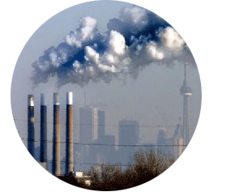
STOCKHOLM CONVENTION
Overview of the Convention
Objective (Article 1) : “ To protect human health and the environment from persistent organic pollutants. ”
3 Groups of chemicals need to be controlled
> Annex 1: Intentionally produced chemicals to be eliminated.
> Annex 2: Intentionally produced chemicals with restrictions.
> Annex 3: Unintentionally produced chemical.
Parties are obliged to take measures to reduce or eliminate releases of POPs covered by the convention.
Notes:
Slide 9 – Overview of the Convention
The Stockholm Convention on Persistent Organic Pollutant (“Stockholm Convention”) came into force in May 2004. This is thereby the newest global environmental treaty in effect.
The objective is simply to protect human health from the impact of POPs. This refers both to direct and indirect effects, and thereby also by necessity includes any kind of release of POP into the environment, regardless of whether humans or animals are the most exposed groups.
12 chemicals are targeted by the convention, but the option to add more chemicals into the convention coverage is clearly stated in the convention text. The 12 POPs are grouped into thee categories:
Intentionally produced chemicals that the convention requires are be eliminated.
Intentionally produced chemicals that the convention still allow restricted use of.
Unintentionally produced chemical, the generation of which is to be eliminated as far as possible.

Slide 37
12 Chemicals Are Targeted
Name of Chemical | SOURCE
 | Pesticides | Industrial Chemicals | By Products
Aldrin | YES
Chlordane | YES
DDT | YES
Dieldrin | YES
Endrin | YES
Heptachlor | YES
Mirex | YES
Toxaphene | YES
 | YES
Hexachlorobenzene (HCB) | YES | YES | YES
Polychlorinated biphenyl (PCBs) |  | YES | YES
Chlorinated dioxins |  |  | YES
Chlorinated furans |  |  | YES
Annex A - Intentionally produced chemicals that need to be eliminated.
Annex B - Intentionally produced chemicals with restrictions.
Annex C - Unintentionally produced chemicals.
Notes:
Slide 10 – 12 chemicals targeted
This slide summarizes the 12 POPs covered by the Stockholm Convention and in what group of chemicals they belong.
The “Dirty Dozen” is the nickname for the 12 particularly nasty cancer causing POPs targeted by the Stockholm Convention. While many countries have banned the pesticides on the list, urgent action is needed to tackle the industrial chemicals, by-products and stockpiles.
1.Aldrin: Pesticide used to protect crops from soil insects. 2.Chlordane: Pesticide used to protect crops from termites. 3.DDT: Pesticide used on crops for vector control. Used on troops during WWII to stop malaria, typhus and other diseases. 4.Dieldrin: Pesticide used to control of insects and disease vectors. 5&6.Dioxin and furans: Industrial by-products, e.g. from pulp and paper making, and from coking plants.
7.Endrin: Pesticide used on field crops and to control rodents. 8.Hexachlorobenzene (HCB) Pesticide and industrial by-product released when plastics are manufactured. 9.Heptachlor: Pesticide used against soil insects and termites. 10.Mirex: Pesticide used against various ants, termites, wasps and bugs. Also used as a fire retardant in plastics, rubber, paint paper and electrical goods. 11.Polychlorinated biphenyls (PCBs) Industrial chemical used in heat exchange fluids, paint additives, carbonless copy paper, plastics and various other industrial applications. Released as by-product. 12.Toxaphene: Pesticide used on cotton, grains, fruits, nuts and vegetables, and to control ticks and mites in livestock.
So far, the Stockholm Convention is mainly covering pesticides (so perhaps less tailored to industry), but the Convention already has clauses for copying with other chemicals (this will be explained later during this session).

Slide 38
Requirements for Different Kinds of POP
ANNEX A - Each Party shall prohibit and/or take the legal and administrative measures necessary to ELIMINATE:
> Its production and use of chemicals in Annex A; > Its import and export of chemicals in Annex A.
ANNEX B - Production and use of chemicals in Annex B should be ELIMINATED, EXCEPT FOR “acceptable purposes”:
> Currently listed: only DDT used for disease vector control. > Industry must cease production of new PCBs immediately; > Industry must eliminate use of in-place PCB equipment by 2025; > Industry must achieve the environmentally sound management of PCB wastes as soon as possible and latest by 2028.
ANNEX C - Parties are to take measures to MINIMIZE or ELIMINATE releases of the unintentionally produced POPs.
Notes:
Slide 11 – Requirements for different kinds of POP
As mentioned above the convention groups the 12 chemicals into three categories, each one referred to in its own Annex to the convention. This slide outlines the requirements for each group of POP.
Production and use of chemicals in Annex A shall be eliminated.
Currently listed: aldrin, chlordane, dieldrin, endrin, heptachlor, hexachlorobenzene, mirex, PCBs, and toxaphene
Some minor exemptions and time limited country-specific exemptions apply, including PCB use in existing equipment (Article 4)
Annex B: Production and use of chemicals in Annex B should be eliminated, except for “acceptable purposes”.
The only acceptable purpose is DDT production and use for disease vector control in cases where the country has registered its intention to this end.
Annex C: The release of these POPs (dioxin and furan) are not intentional but signatories to the Stockholm Convention commit themselves to actively pursue minimization/phase-out of these releases.
Specifically on PCB in industry (annex B)
- Used in transformers and capacitors
- Used as heat exchange fluids
- Used as hydraulic fluids
- Component of paints, plastics, …
3 main goals:
- cease production of new PCBs immediately
i.e., entry into force of the Convention
- eliminate use of in-place PCB equipment by 2025
until then continued use is subject to conditions and restrictions
- achieve the environmentally sound management of PCB wastes as soon as possible and by 2028
Parties report to the COP every 5 years on progress
COP to review progress toward 2025 & 2028 targets every 5 years

Slide 39
Action Plan for Unintentionally Produced POPs
1. Manufacturing process where use of chlorine-containing materials is essential:
> Pulp & paper (bleaching)
> Chlorinated chemical productions (synthesis of chlorinated aromatic chemicals, chlorinated solvents, PVC, ..)
> Oil refining and catalyst generation
2. Production application/use with chlorine-containing materials:
> Preservation of wood, leather, textiles
> Textile and leather dying
> Industrial bleaching processes
> Processes which involves solvents
> Water and wastewater disinfection
3. Thermal processes with chlorine-containing materials incidentally present
4. Other thermal processes
> Metallurgical process, primary and secondary processes (Cu, Fe, Al, Zn)
> Coke production and carbo-chemical processes
> Mineral processing; especially cement kilns
5. Controlled combustion processes:
> Waste incineration
> Coal and oil combustion
> Landfill gas/biogas
Priority focus for Cleaner Production
Notes:
Slide 12 – Unintentionally produced POPs
Annex C: Stipulate the difference between ‘intentionally’ and ‘unintentionally’ produced POPs; especially dioxins and furans are not a product by itself but unfortunately often a by-product, partially unavoidable, partially avoidable (depending on production process and its conditions)

Slide 40
Action Plan for POP as By-Products
To reduce release of POPs BY-PRODUCTS, each Party shall:
> Develop and implement an action plan to evaluate release and then take steps to address them;
> Promote application of measures to achieve realistic and meaningful levels of release reduction or source elimination;
> Promote development and use of substitute or modified materials, products and processes to prevent release of POPs.
Notes:
Slide 13 – POP as by-products
Annex C (unintentionally generated POPs): Specific requirements:
> Develop within 2 years of entry into force and implement an action plan to evaluate release and then take steps to address them;
> Promote application of available, feasible and practical measures to achieve realistic and meaningful levels of release reduction or source elimination;
> Promote development and require use of substitute or modified materials, products and processes to prevent release of POPs.

Slide 41
Action Plan for Stockpiles and Wastes
To manage STOCKPILES and WASTE, each Party shall:
> Develop strategies for identifying stockpiles, products and wastes containing POPs;
> Manage POPs stockpiles and wastes in an environmentally sound manner;
> Dispose of POPs wastes in manner consistent with international rules;
> Disposal that recycles POPs is not permitted;
> Transport of POPs wastes is not permitted without taking into account international rules.
Notes:
Slide 14 – Stockpiles and wastes
A specific aspect of POP management is the many times large quantities of chemicals that are stockpiled or just abandoned, either because they are considered as waste, or as an effect of earlier national requirements banning the use of these chemicals. These are many times not accounted for, kept in unsafe manners, and without any identifiable owner. For this reason it is essential that governments develop plans and strategies for handling these stockpiles.

Slide 42
Arrangement for Implémentation & Financial Resources
DEVELOPED COUNTRIES
> Parties from developed countries shall provide new and additional funding to developing countries and countries with economies in transition.
FINANCIAL MECHANISM
> There will be a financial mechanism established under the treaty (undefined yet) to assist countries in its implementation.
GLOBAL ENVIRONMENT FACILITY (GEF)
> On an interim basis GEF will serve as the principal financial mechanism of the Convention until the COP decides on the institutional structure of the permanent financial mechanism.
Notes:
Slide 16 – Financial resources
The developed country signatories to the Stockholm Convention will provide funding to developing countries to meet their commitments under the convention.
GEF is to fulfill the interim financial function of the Convention through operational measures related specifically to POPs.
- The “new and additional” funding shall complement, not substitute, existing aid programs
- The funding should support projects with global environmental benefits for which official development funds are not normally available
- The funding should cover the added (incremental) costs necessary to protect the global environment beyond what is necessary for national development

Slide 43
Earth summit 1992
Also called as
Rio Earth Summit.
Rio de Janeiro Earth Summit
Rio Summit
Rio Conference
The Earth Summit
United Nations Conference on Environment and Development (UNCED)
It took place in Rio de Janeiro city of Brazil on 3rd and 14th June 1992.
Reference Link
https://www.un.org/en/conferences/environment/rio1992

Slide 44
Earth summit 1992
It was a major event of the United Nations and brought together political leaders, diplomats, scientists, representatives of the media and non-governmental organizations (NGOs) from 179 countries for a massive effort to focus on the impact of human socio-economic activities on the environment. The date was chosen as the occasion of the 20th anniversary of the first Human Environment Conference in Stockholm, Sweden, in 1972.

Slide 45
objective
The objective of the summit was to achieve at a consensus on development that would minimize the impacts on environment. More commonly speaking it addresses the issue of sustainability due to socio and economic activities of human beings. The protection of the environment due to development was the central underlying idea.
Following issues were addressed in this summit.
Systematic scrutiny of patterns of production—particularly the production of toxic components, such as lead in gasoline, or poisonous waste including radioactive chemicals
Alternative sources of energy to replace the use of fossil fuels which causes global climate change
New reliance on public transportation systems in order to reduce vehicle emissions, congestion in cities and the health problems caused by polluted air and smoke
The growing usage and limited supply of water

Slide 46
Achievements of rio earth summit
Following are the achievements of Rio Earth Summit.
One of the most important achievement of the summit was an agreement on the Climate Change Convention which in turn led to the Kyoto Protocol and the Paris Agreement.
Another achievement as an agreement to "not to carry out any activities on the lands of indigenous peoples that would cause environmental degradation or that would be culturally inappropriate".
In addition, the Rio Earth Summit resulted into three 3 documents.
Rio Declaration on Environment and Development
Agenda 21
Forest Principles

Slide 47
Moreover, three important legally binding agreements (Rio Convention) were opened for signature for all countries
Convention on Biological Diversity
UN Framework Convention on Climate Change (UNFCCC)
United Nations Convention to Combat Desertification

Slide 48
a. Rio Declaration on Environment and Development
Rio Declaration proclaims 27 principles demonstrating "integral and interdependent nature of the Earth, "our home“.
The principle states that sustainable development primarily concerns human beings, who are entitled to live healthy and productive lives in harmony with nature.
They creates an expectation that states will enact environmental legislation.
It also includes formulations of the precautionary principle, which should be “widely applied by states according to their capabilities”.
It also encourages the “polluter pays principle” in which states are encouraged to adopt where it is in the public interest to do so and it will not distort international trade and investment.

Slide 49
b. Agenda 21
Agenda 21 is a non-binding action plan of the United Nations with regard to sustainable development.
It is an action agenda for the UN, other multilateral organizations, and individual governments around the world that can be executed at local, national, and global levels.
Major objective of the Agenda 21 initiative is that every local government should draw its own local Agenda 21.
Its aims to achieve global sustainable development by 2000, with the "21" in Agenda 21 referring to the targets of the 21st century.
There are 4 mains sections of this Agenda 21

Slide 50
Sections of Agenda 21
Section I: Social and Economic Dimensions is directed toward combating poverty, especially in developing countries, changing consumption patterns, promoting health, achieving a more sustainable population, and sustainable settlement in decision making.
Section II: Conservation and Management of Resources for Development includes atmospheric protection, combating deforestation, protecting fragile environments, conservation of biological diversity (biodiversity), control of pollution and the management of biotechnology, and radioactive wastes.
Section III: Strengthening the Role of Major Groups includes the roles of children and youth, women, NGOs, local authorities, business and industry, and workers; and strengthening the role of indigenous peoples, their communities, and farmers.
Section IV: Means of Implementation includes science, technology transfer, education, international institutions, and financial mechanisms.

Slide 51
c. The Forest Principles
Forests cover approximately 30 per cent of the Earth’s land surface and provide important ecosystem goods and services, including food, fodder, water, shelter, nutrient cycling, air purification, and cultural and recreational amenities. Forests also store carbon, provide habitat for a wide range of species and help alleviate land degradation and desertification. Hence it becomes extremely important to protect them.
“Forest Principles” is a non-legally binding authoritative statement of principles for a global consensus on the management, conservation and sustainable development of all types of forests.
This documents makes several recommendations for sustainable development of forestry.

